Slide 1
MY EDUCATIONAL TIMELINE
BY: JULIA MINAKER
T00590108

Slide 2
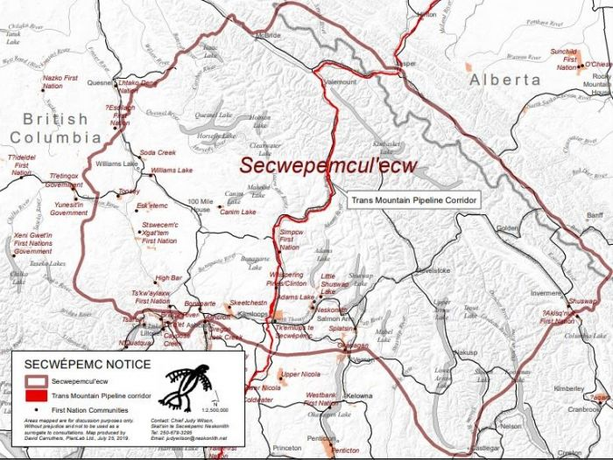
As a TRU student I want to begin by acknowledging that I am grateful to attend university on the unceded territories of the Tk’emlups te Secwepemc ne Secwepemcúl'ecw.
This Photo by Unknown Author is licensed under CC BY-NC

Slide 3

FOOD FOR THOUGHT
This assignment has shown me the value of my educational journey. Not often do I remember a specific lesson, or teacher. But rather, I remember these 8 moments. None of them tell you that I failed math in grade 10, or that I made honor roll. They also don’t tell you I really disliked my grade 9 science teacher. Instead, by combining these moments in a timeline, you can establish a sense of who I am in this world. I had my fair share of struggles, but also maintained a balance of successes. Life is just one long timeline of moments that we often fail to see. Here is my educational timeline of the moments that made me.

Slide 4

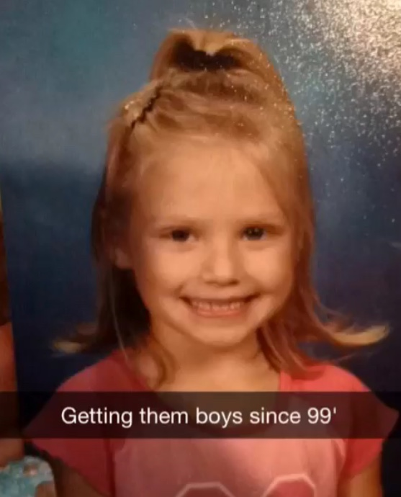
NAME: Julia Minaker
AGE: 6
GRADE: Kindergarten
THE BEGINNING
Although I don’t remember much, I know kindergarten was a great time. A day filled with mostly play-time, friendship, and learning to spell my first name; J-U-L-I-A. I began school in French-immersion and continued throughout my schooling. As a young, naïve girl, in a very big world I noticed my place, or rather the bigger picture. My world would soon be multiplied and so were my friendships, my understanding of the world, and my wicked ability to never stop talking. I was discovering the world was so big, and I was so small. Only to later find out it gets much, MUCH bigger.

Slide 5

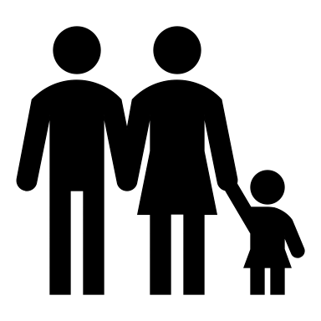
EARLY LIFE
With my new understanding of the big world I inhibit, I discovered the world is not always in my favor, it felt like it was against me most of the time. After my parents went through a messy divorce, I began to normalize living a stressful life. At ten years old I had been to 5 different guidance counsellors, therapists, and psychologists. This pulled me away from my growing mind. I focused on finding safety in my life, instead of learning and understanding what I was being taught. Most of my elementary school years I felt like the ‘broken’ kid. Embarrassed by my parents, and the lack of love I felt, I focused on being accepted socially. However, academically I was facing barriers.

Slide 6

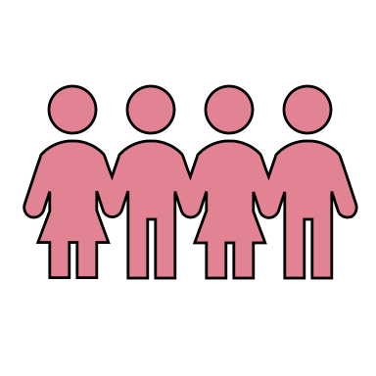

BUILDING A SUPPORT SYSTEM
A large part of my education journey was an after-school program my elementary school offered. It focused on empowering young girls and supporting diversity. This forced me to go outside of my comfort zone and expand my friendships with people I was not normally comfortable associating with. I also now realize humans, especially young teens, have such a tendency to pick and choose people they want to be friends with solely based on looks, whereas now I realize I base my friendships on genuine connection and people who value life and have motivation similar to my own.
GO
GIRLS

Slide 7


FÉLICITATIONS, VOUS POUVEZ PARLER FRANÇAIS!
A memorable highlight in my educational journey was finishing my French-immersion program. I was rewarded with a trip to Old Quebec and got to explore a completely different culture. I had never been anywhere outside of BC before, and I did a full day in a Québécois classroom. This experience taught me gratitude. I experience the world in a new lens, and a new language, surrounded by people I didn’t know. I also discovered the education system is not always linear. Québécois students had different style, slang, and norms that I did not comprehend. This was just another continuation of my discovery of just how big the world is.
QUEBEC CITY
CONGRATULATIONS,
YOU CAN SPEAK
FRENCH NOW!
LANGLEY, BC

Slide 8

History and curriculum are often taught as a dominant culture’s justification for its actions. I didn’t hear about the residential school system until I got to high school. Being honest, I didn’t really understand what it was, or why it was so upsetting to some, I only knew it was bad. As high school went on, I experienced the worst loss I will ever experience, and lose the place that feels like home. Although this place is not actually a “place” at all, it is where I feel safest. This was taken away from me. I said goodbye to my mother in February of 9th grade. I never connected this loss with anything until I began Indigenous studies at TRU. As a Canadian born, Caucasian woman I could never imagine my place being taken from me like the Canadian Government has done to Canadian Indigenous peoples. The world has not come close to stripping me of my culture, identity, home, and much more and for that I am grateful, and I am sorry. But the world did take away my happy place, and the person I always called home. A core value in Indigenous culture is storytelling and passing along experiences, this is how I am expressing my story to share with you.
THE
EPIPHANY

Slide 9
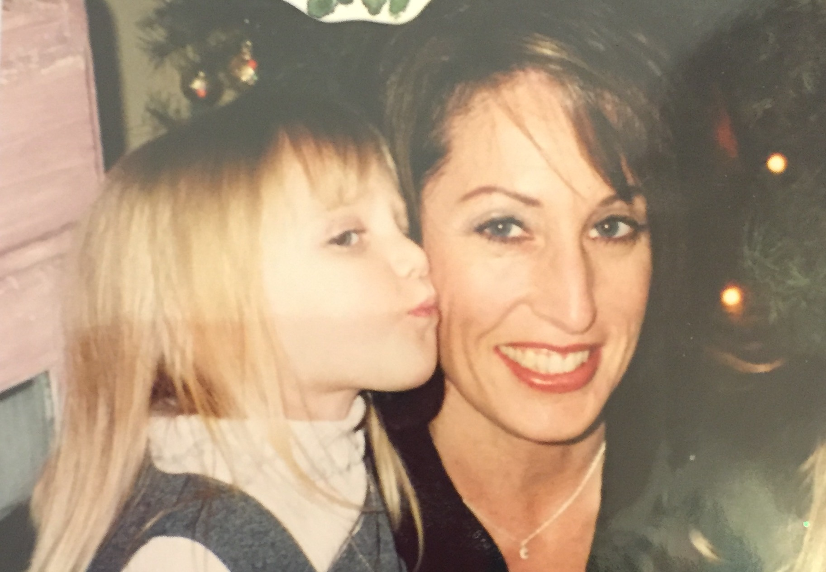

This Photo by Unknown Author is licensed under CC BY
MY TRIBUTE TO LOSS
I will never understand, therefore I will stand,
in order to understand the best I can.

Slide 10

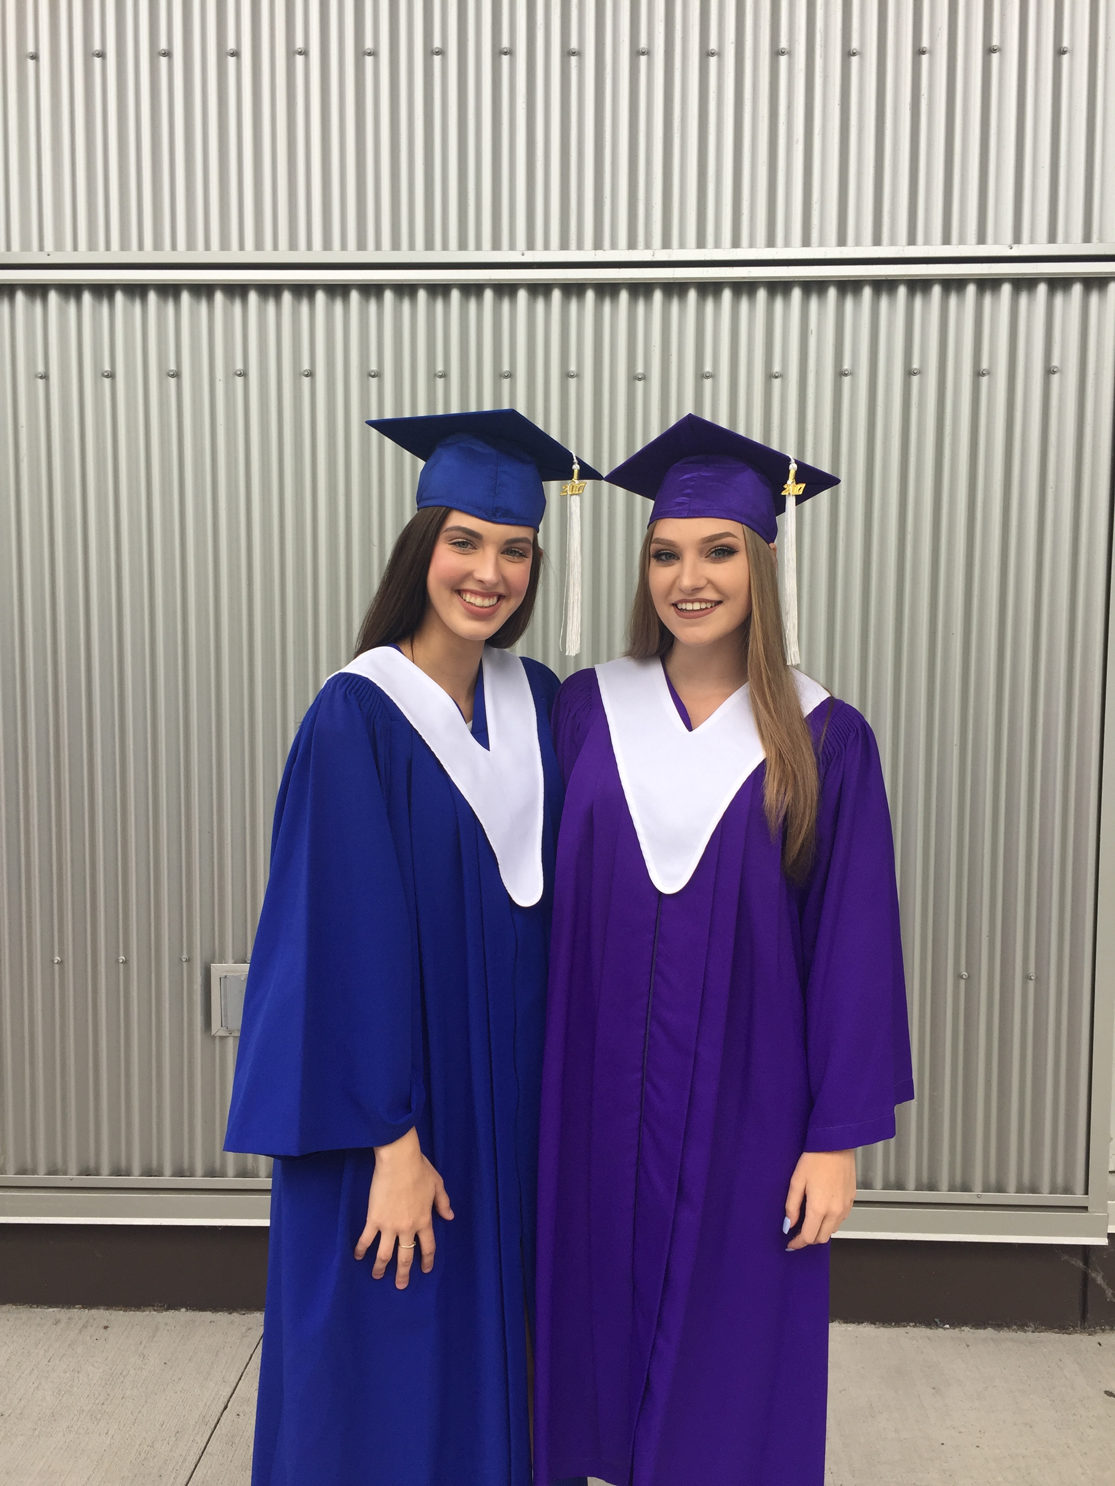
THAT’S ME! GRADUATING
(BARELY)
A huge accomplishment through my education journey was graduating high school. This is easily a common milestone for most teenagers. For me, the motivation at the end of my grade 12 year was gone. I didn’t care about school or finishing the last month of my final semester. Mental health was a lingering issue that I didn’t fully understand. I learned that year what it truly meant to be resilient. I needed to push to take care of my mental health, just as much as my physical health. If I had chosen to succumb to my mental health, I would not be doing this assignment today.

Slide 11

CURRENTLY…
Independence was a lesson I learned young. After losing a parent I felt like I had to mature quicker than most. I didn’t become aware of my independence until I chose to pursue post-secondary at TRU. Moving to Kamloops and separating myself from everything that made me feel safe and comfortable was a large part of my educational journey, and maturing into the person I am. I became responsible for my own future. University was not mandatory, it was a choice, and a privilege. Establishing this independence forced me to figure out the beginning of my journey of who I wanted to be in this world - an educator, a friend, a support for a child in need, and much more.
This Photo by Unknown Author is licensed under CC BY-NC

Slide 12
THANK YOU FOR TAKING YOUR TIME TO LISTEN TO MY STORY.

